Slide 1
Human Activity Recognition
Edwin Candinegara

Slide 2
Objectives
Real-time Smartphone based Human Activity Recognition
Smartwatch based Human Activity Recognition
Notes:
= Data collection process → documentation
= Activity description
Versus available data currentls

Slide 3
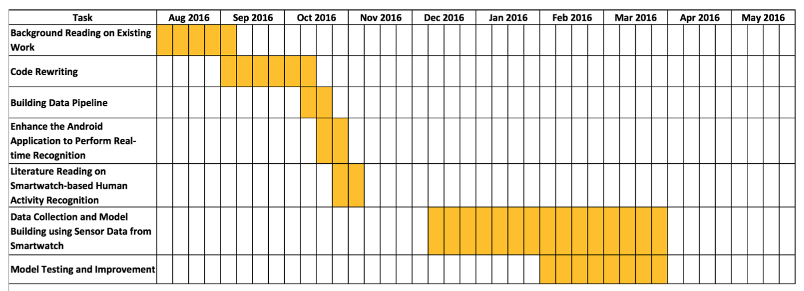
Project Timeline

Slide 4
What’s done?
Code rewriting from scratch
Python for server and Machine Learning stuffs
Java for Smartphone
HTML, CSS, and Javascript for Smartwatch
Ready to use data pipeline
Data collection, data sampling, data segmenting, features generation, model training, model testing (K-Folds cross validation)
Easy to change pipeline configuration
Initial model trained using my own data with different kind of classifiers
Random Forest, SVM, Naive Bayes, Multi Layer Perceptron

Slide 5
What’s done?
A simple data visualizer
AngularJS with Python server
Beautifully visualize the raw data
The real-time activity monitor will be incorporated in this web application
Gathered full data from one friend (15 activities, 6 mins each)
Tried a simple LOO (trained using my data, tested with my friend’s data)
Problems with the sensor readings range (see graph comparison in next slide)

Slide 6
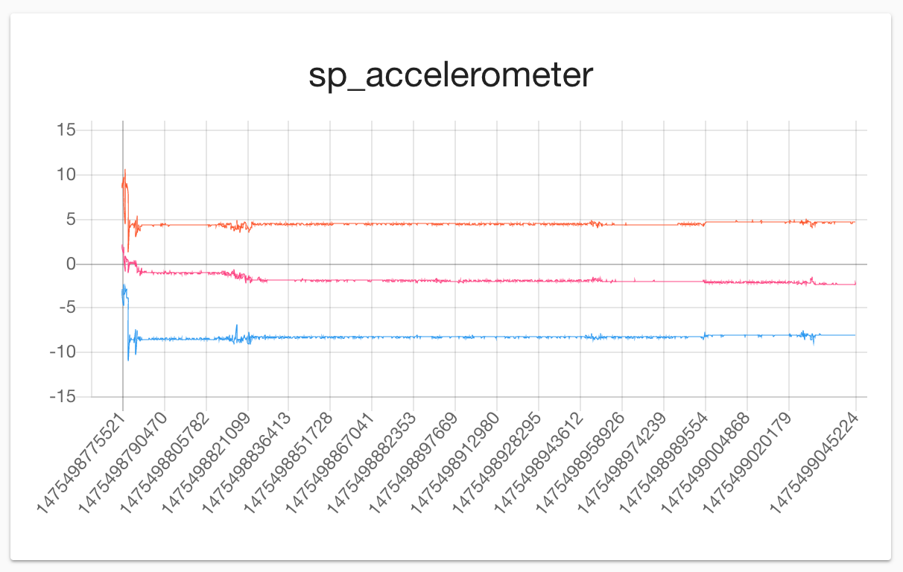
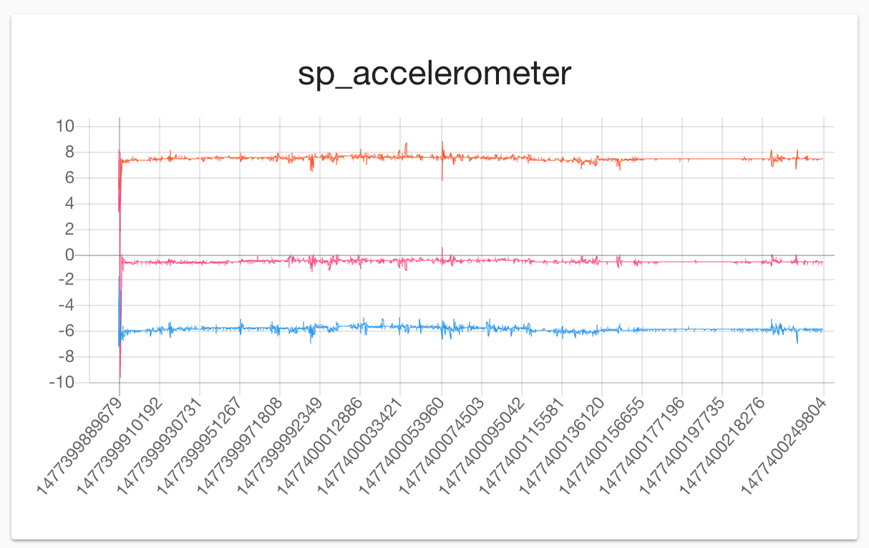
My Data
My Friend’s Data
Result is very bad (and I think this is likely to happen even when we have collected more data from more subjects)
If a small part of my friend’s data is included (around 100 data points chosen randomly), the accuracy is boosted significantly
Random Forest → from ~45% to ~80%
Possible reasons:
Different data range
Even after min-max normalization (min-max is taken from the training data), the normalized data may be greater than 1 or lower than 0

Slide 7
Observations
The data combination of Smartphone and Smartwatch increases the prediction accuracy
Model trained only using the Smartwatch data is better than if it is trained using the Smartphone only
Most likely because most activities are focused on hand-activities
Using only accelerometer data may be sufficient to get high accuracy
Need to verify by doing LOO CV
Bigger window size increases the accuracy
More context is captured by the features and hence the model

Slide 8
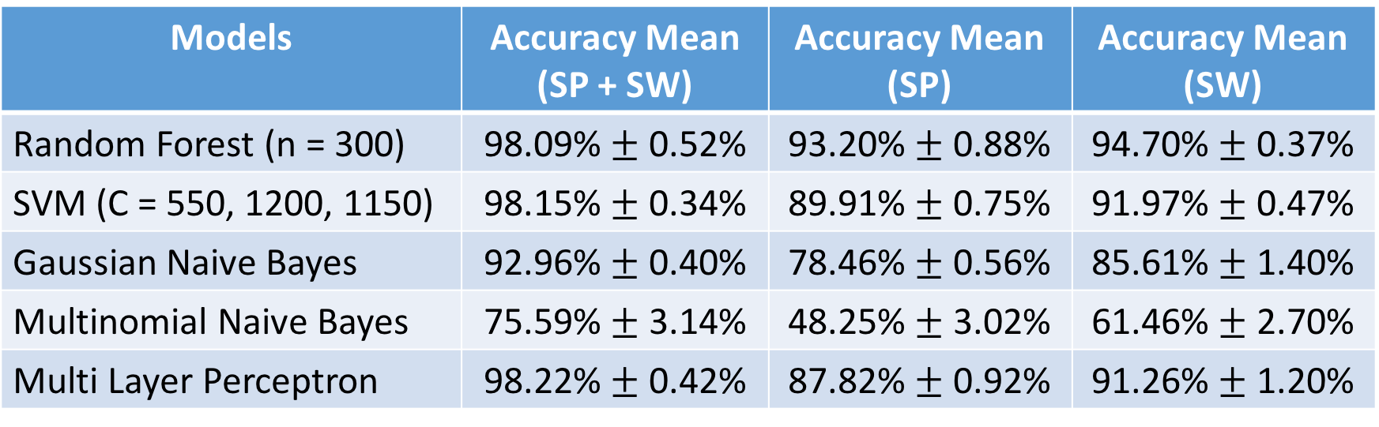
Model Performance Comparison
15 activities, Sampling @ 10 Hz, Window size = 2s
Models | Accuracy Mean (SP + SW) | Accuracy Mean (SP) | Accuracy Mean (SW)
Random Forest (n = 300) | 98.09% $±$ 0.52% | 93.20% $±$ 0.88% | 94.70% $±$ 0.37%
SVM (C = 550, 1200, 1150) | 98.15% $±$ 0.34% | 89.91% $±$ 0.75% | 91.97% $±$ 0.47%
Gaussian Naive Bayes | 92.96% $±$ 0.40% | 78.46% $±$ 0.56% | 85.61% $±$ 1.40%
Multinomial Naive Bayes | 75.59% $±$ 3.14% | 48.25% $±$ 3.02% | 61.46% $±$ 2.70%
Multi Layer Perceptron | 98.22% $±$ 0.42% | 87.82% $±$ 0.92% | 91.26% $±$ 1.20%

Slide 9
What to do in December?
Gather 2-3 more friends’ data
Perform LOO Cross Validation
Start thinking and developing the real-time recognition system
Interim report
Notes:
LOO testing
Domain Transfer Learning
- Collect data from one set of SP and SW
- Test it using another set of SP and SW

